Slide 1

MultipleAI
SOLUTIONSS

Slide 2


Slide 3
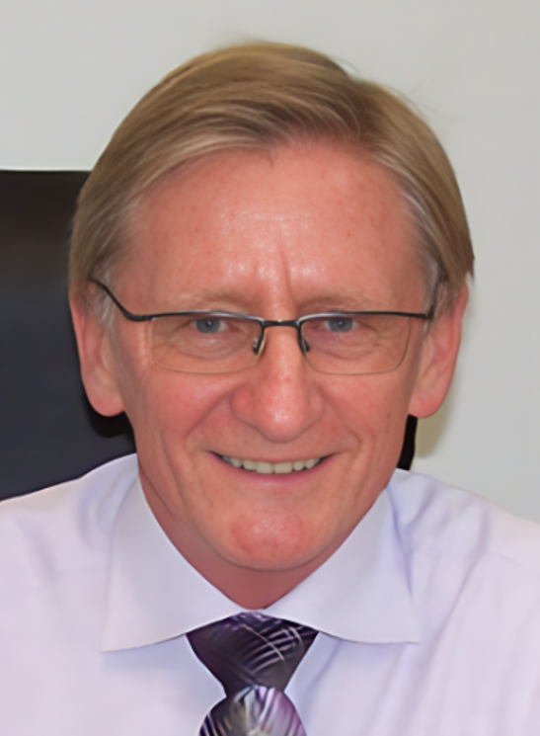
Terry Smith CFO

